Slide 1
Search Python Project
Members:
Teresa Lopez
Pady Rodriguez
Julieta Escalera

Slide 2
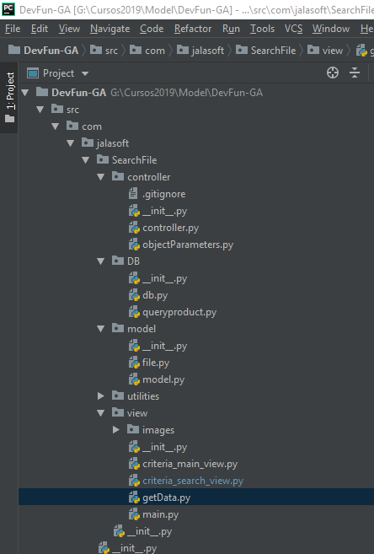
Structure

Slide 3
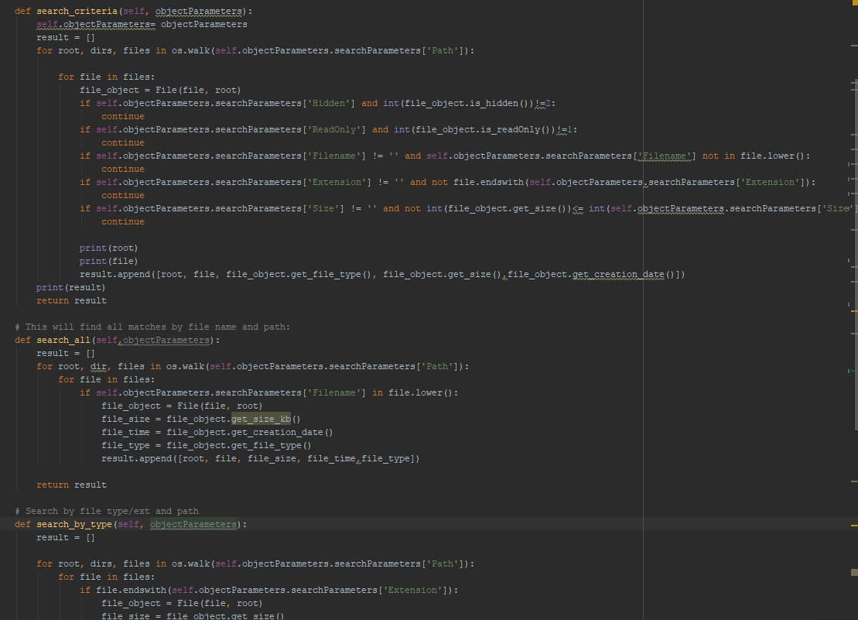
Model

Slide 4
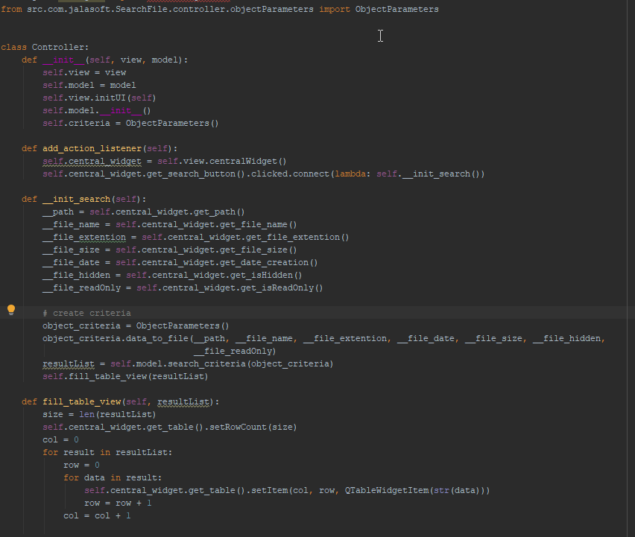
Controller

Slide 5
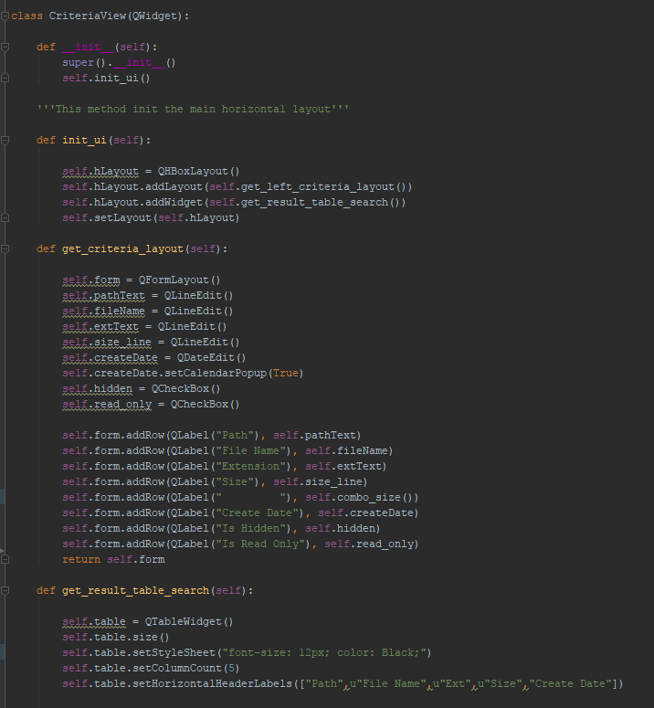
View

Slide 6
